Slide 1


Slide 2
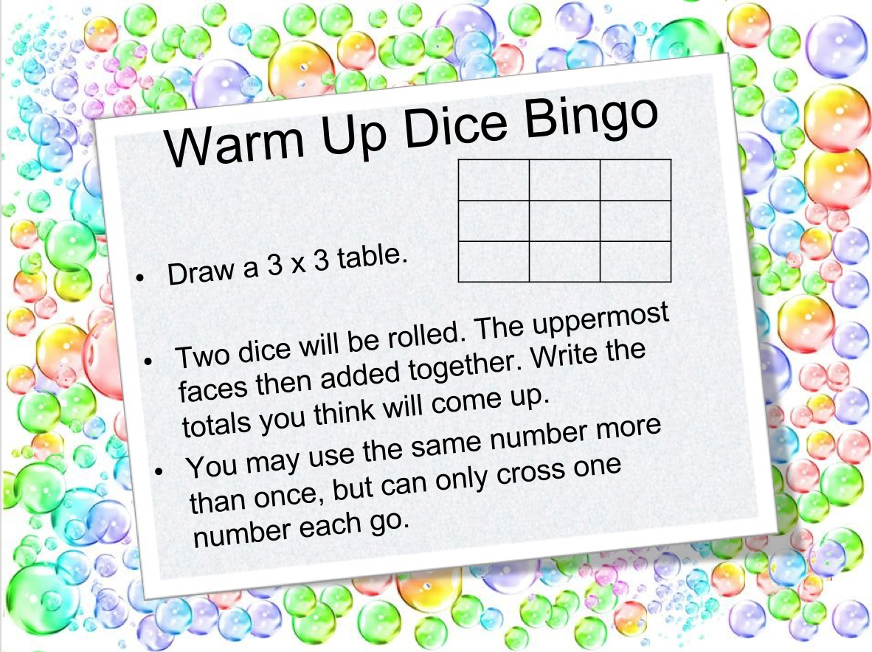

Slide 3
Consider the following
Have a think about the following questions.
Do you like football?
Do you like music?
I might be interested to find out if people liked both (or neither).
So let’s set it up like this…
 | Like M | Dislike M
Like F
Dislike F
Total
Total
This is a two-way table!!!

Slide 4
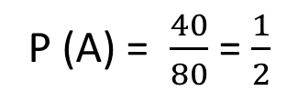
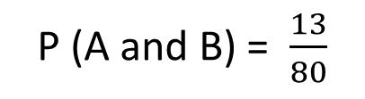
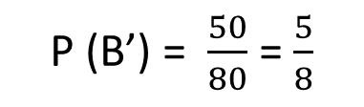
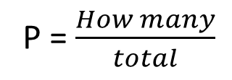
24
7
30
Date
Two-Way Tables
EQ – How can obtain probabilities from a two-way table?
What is a two-way table?
Two-way tables lists the number of outcomes (or people) in different categories, with totals at the bottom.
We display them like this.
Not A
 |  | Event A
 |  | A | A’ | Total
Event B | B
 | B’
 | Total
13
17
30
27
23
50
40
40
80
How do we find probabilities?
P = $\frac{How many}{total}$
P (A) = $\frac{40}{80}$ = $\frac{1}{2}$
P (A and B) = $\frac{13}{80}$
P (B’) = $\frac{50}{80}$ = $\frac{5}{8}$
7

Slide 5
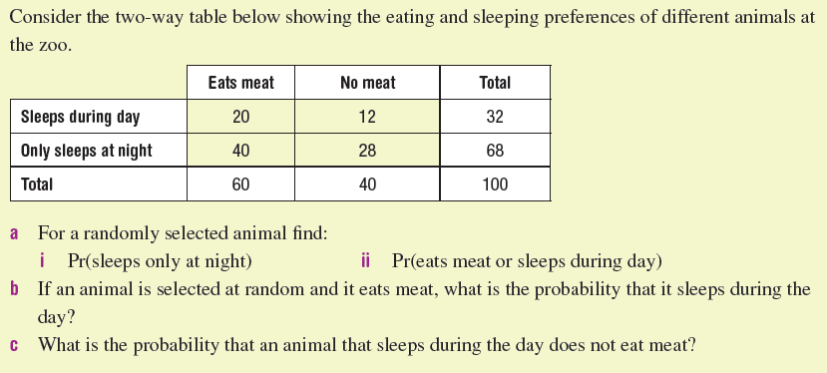
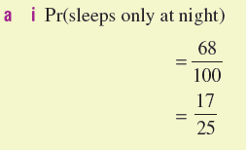
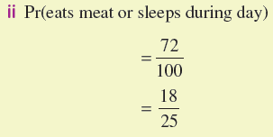
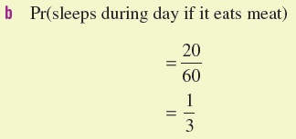

Let’s try this together

Slide 6
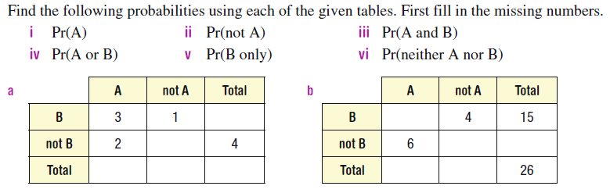
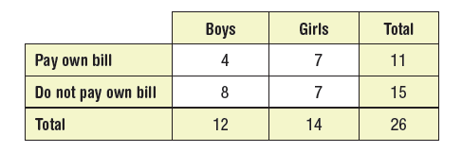
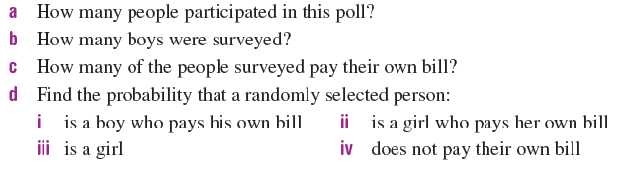
Your Turn (LHS)

